Slide 1
게임엔진2 제6주
Teleport/Socket 구현
드론IoT시뮬레이션학부
담당교수 : 이형원
E304호, hwlee@inje.ac.kr

Slide 2
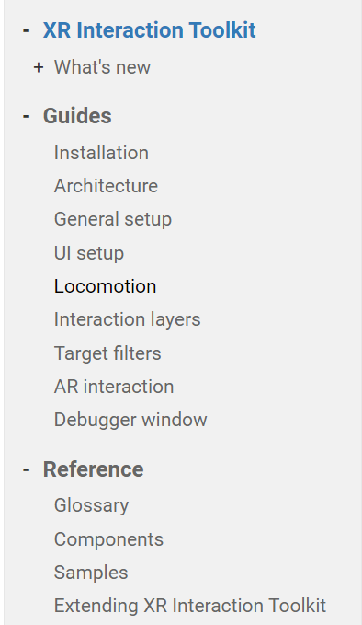
XR Interaction Toolkit Guide
XR Interaction Toolkit | XR Interaction Toolkit | 2.2.0 (unity3d.com)

Slide 3
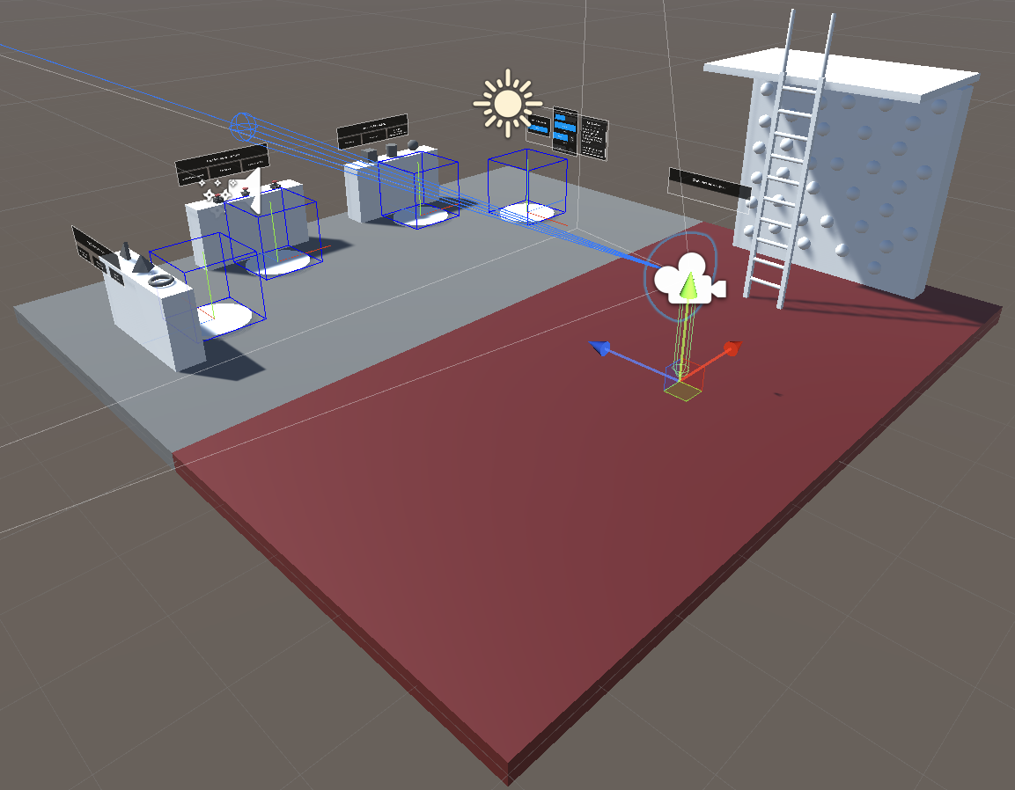
Teleportation
TeleportAnchor
Teleportation Provider
Moving Origin
TeleportArea
Object surface to move
TeleportAnchor
Pre-determined position
rotation
Teleportation Provider
TeleportArea

Slide 4
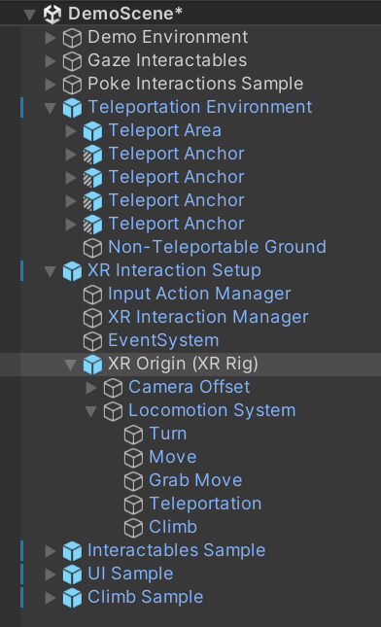
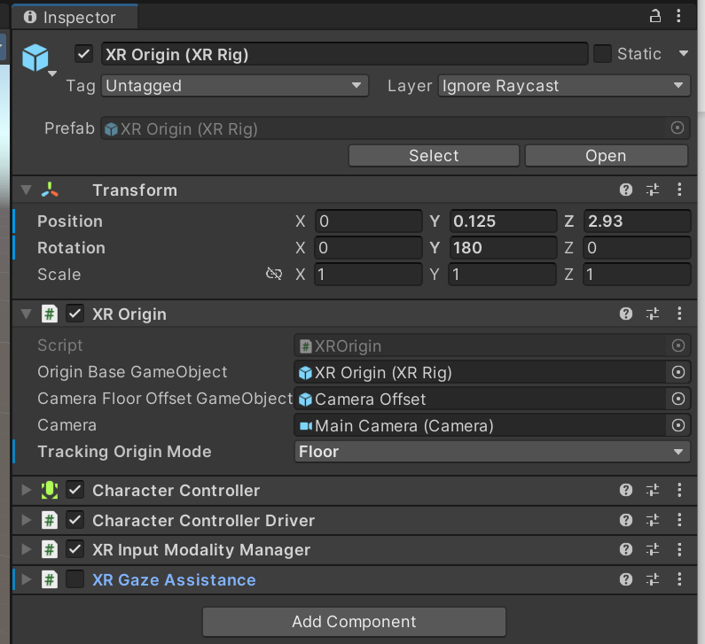
Teleportation Provider

Slide 5
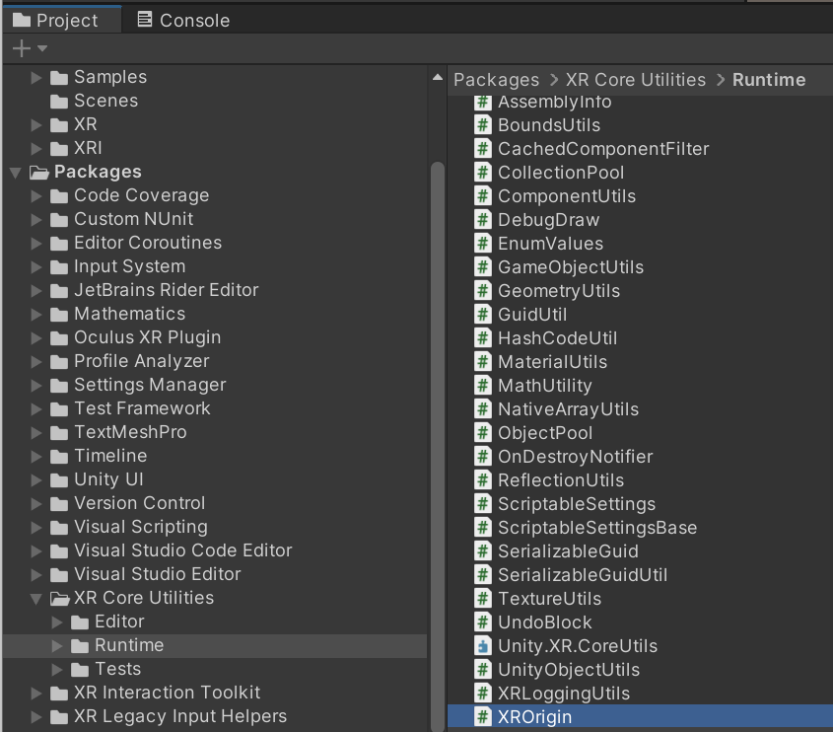
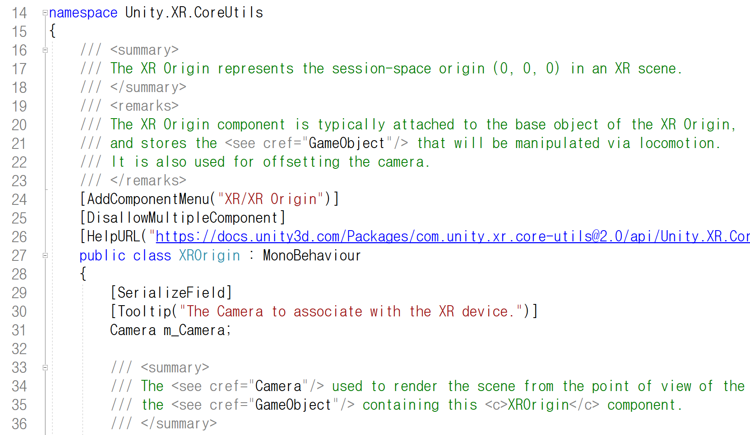
XR Origin Script

Slide 6
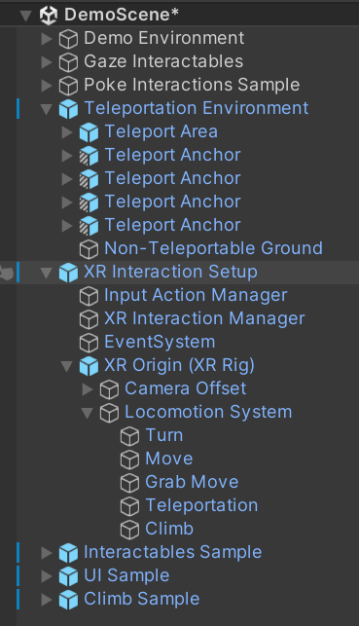
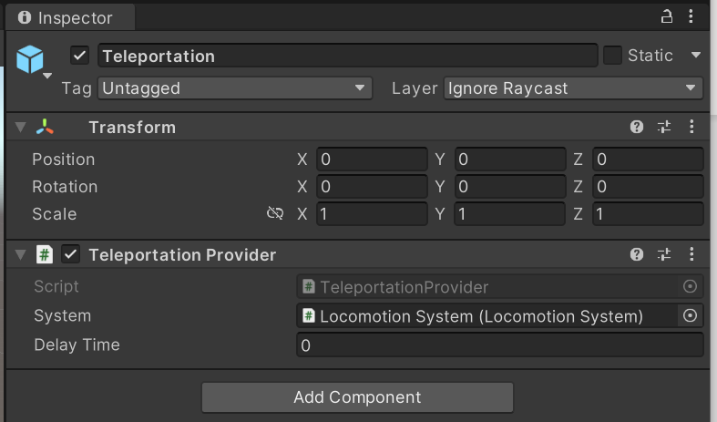
Teleportation Provider

Slide 7
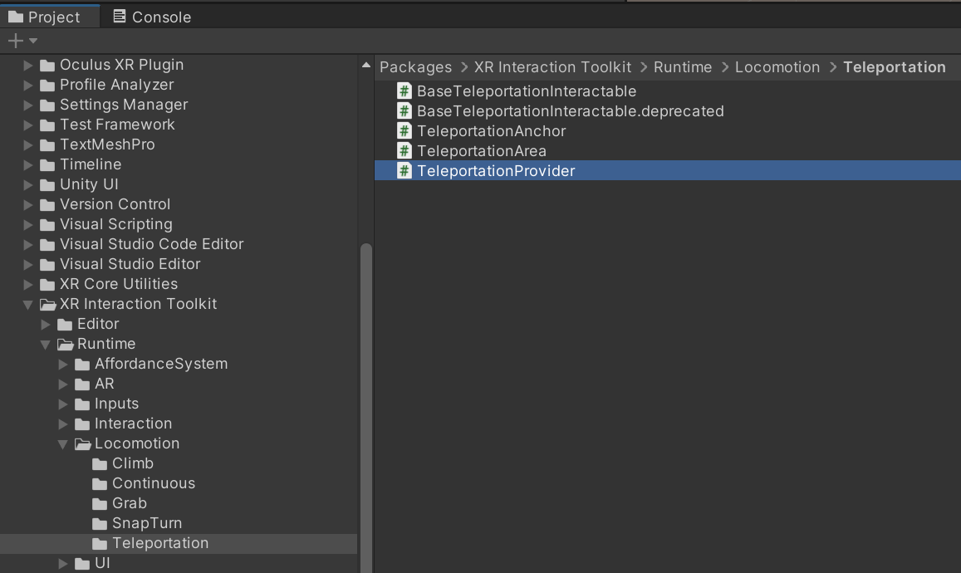
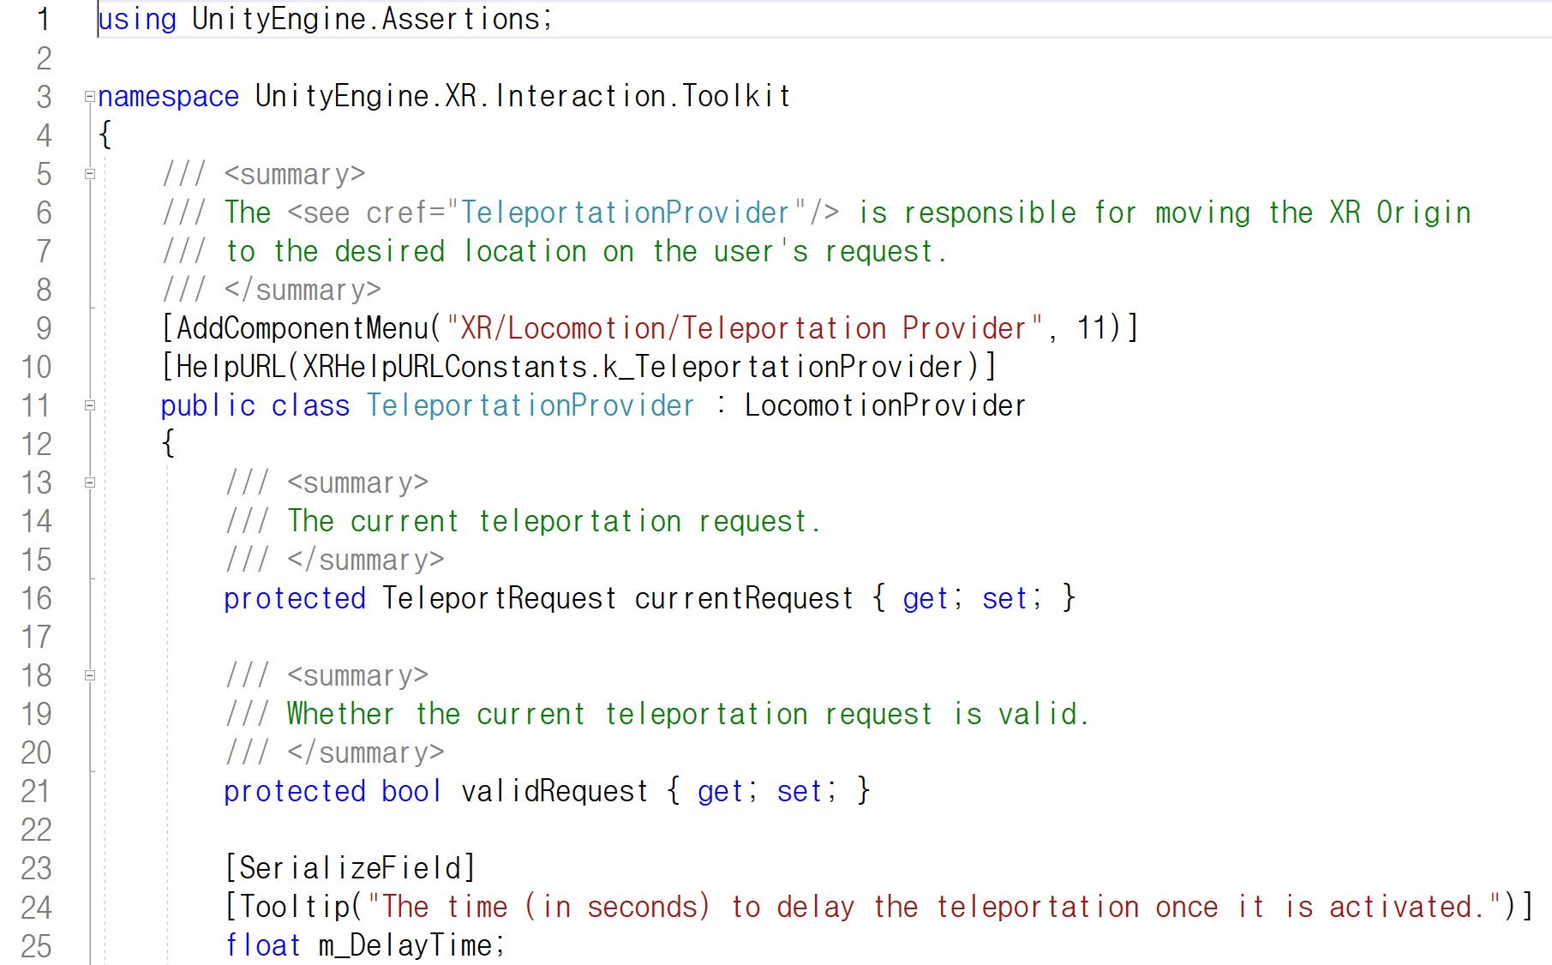
Teleportation Provider script

Slide 8
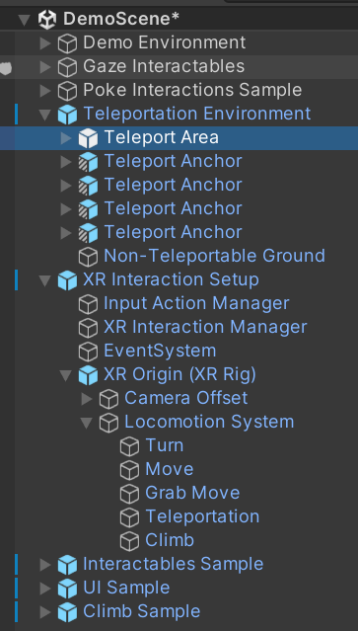
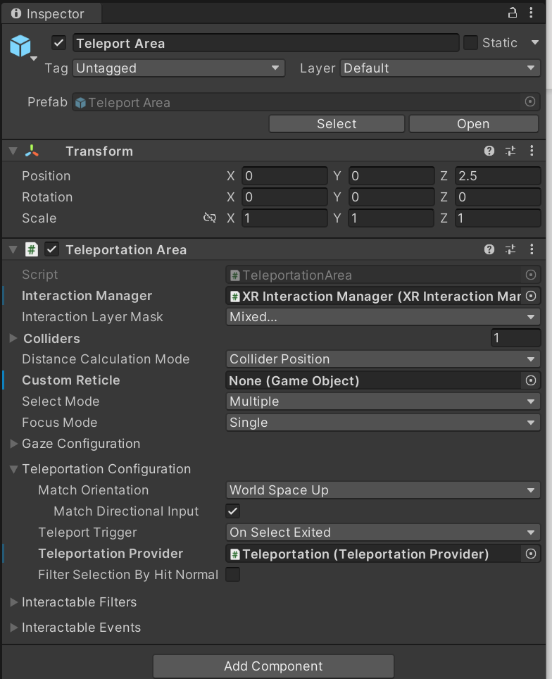
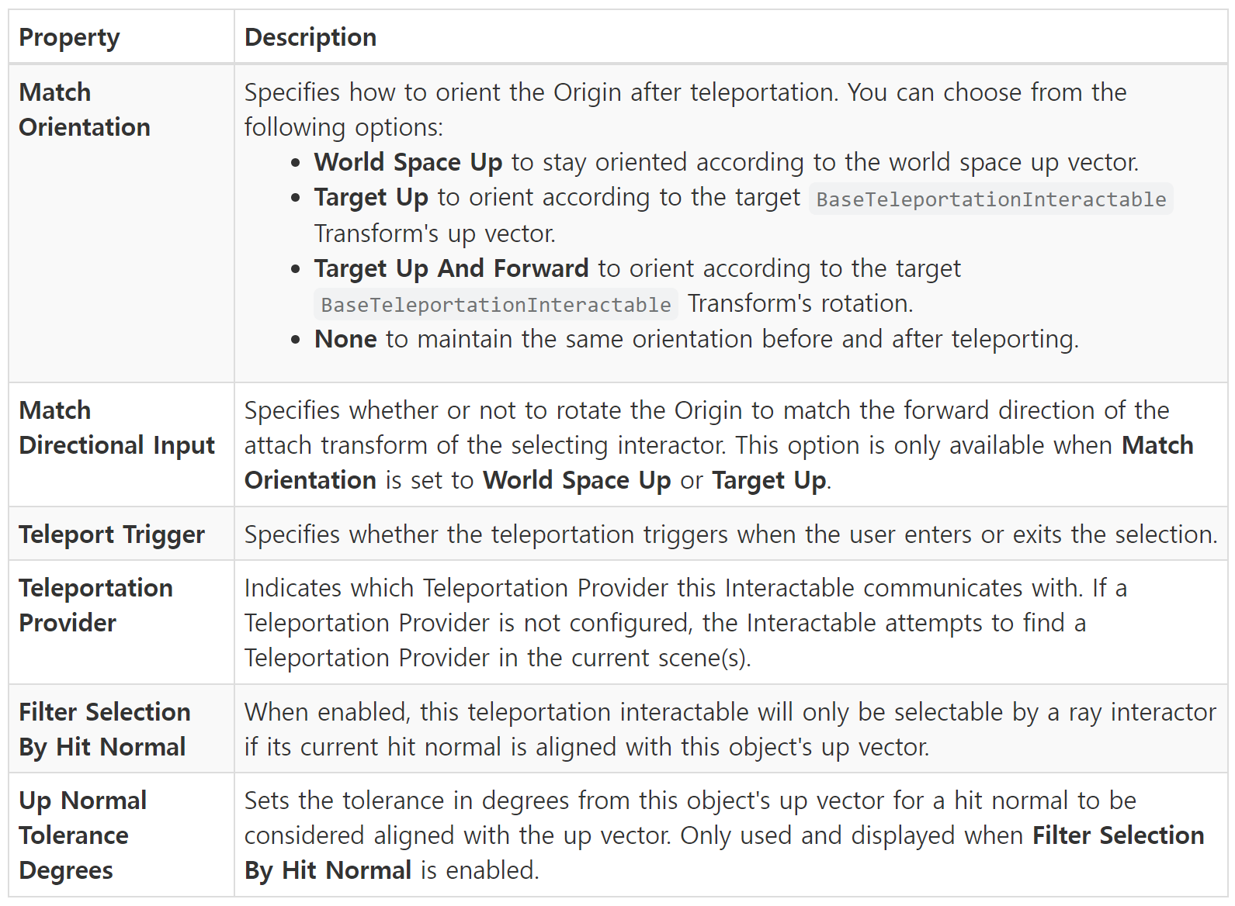
Teleport Area

Slide 9
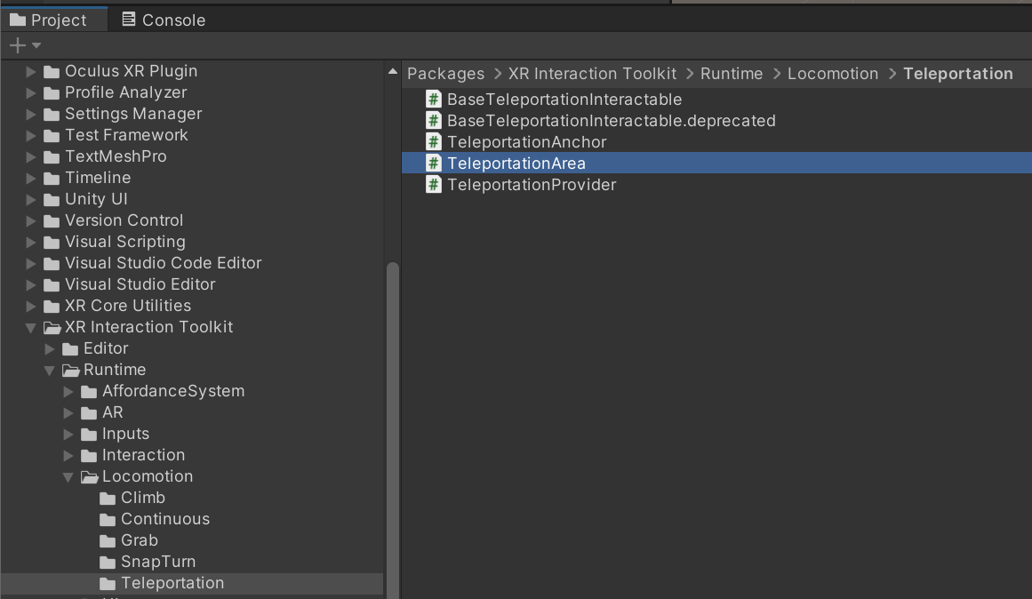
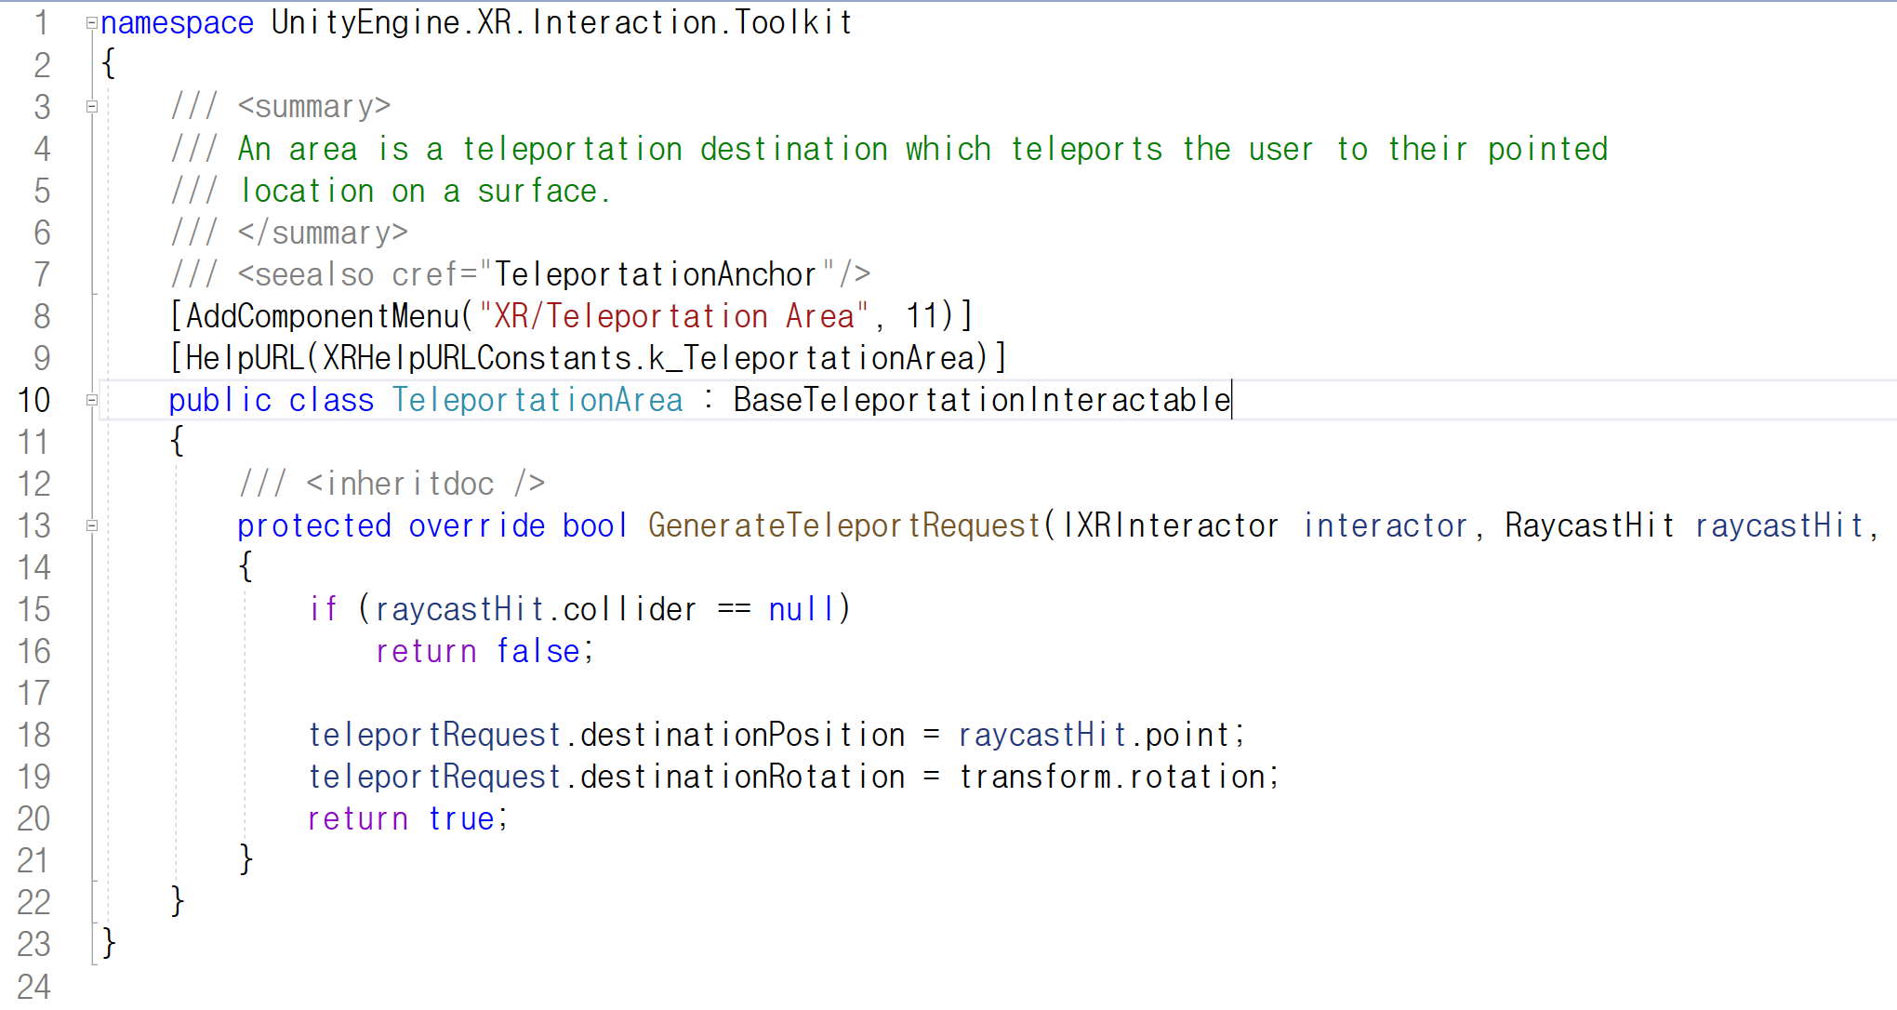
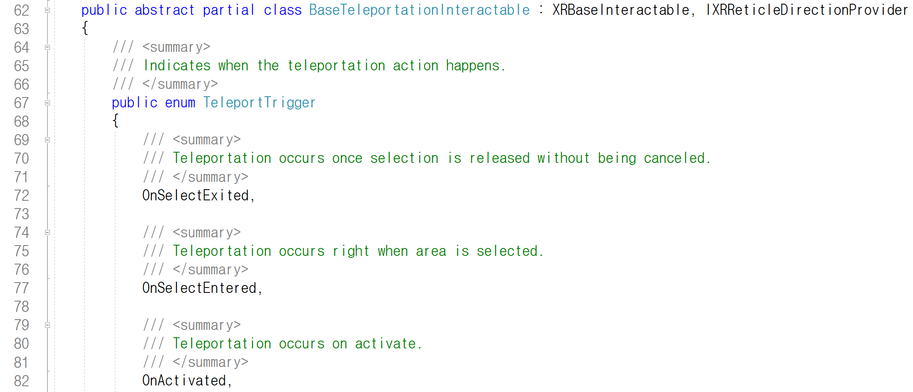
TeleportArea script
BaseTeleportationInteractable

Slide 10
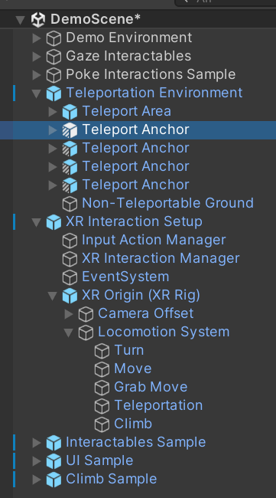
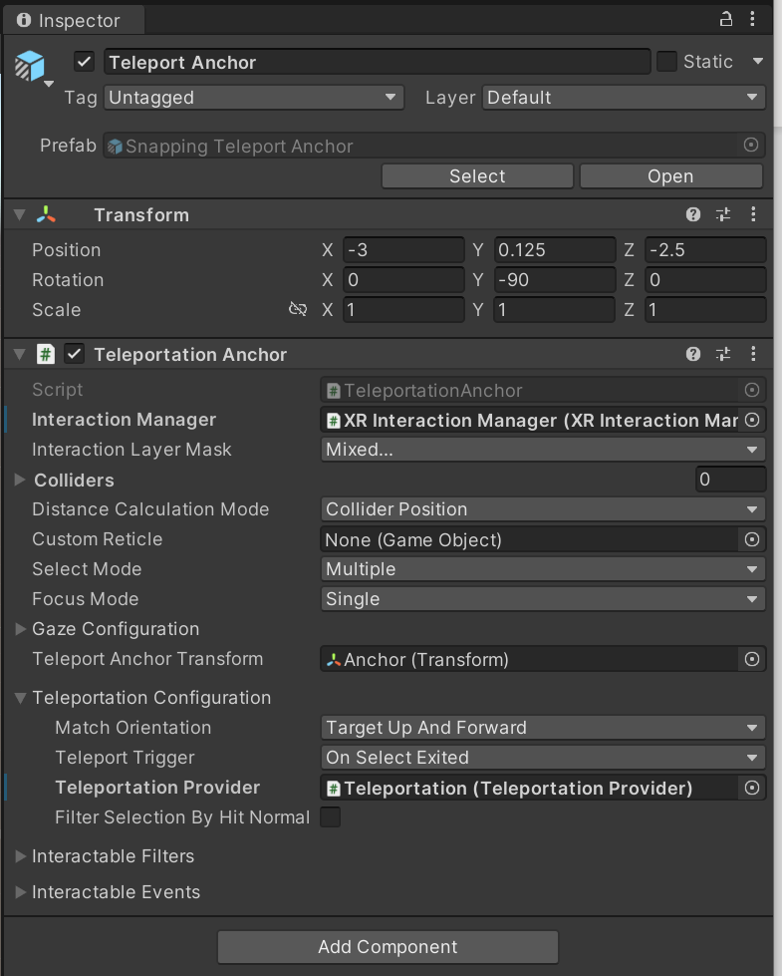
Teleport Anchor

Slide 11
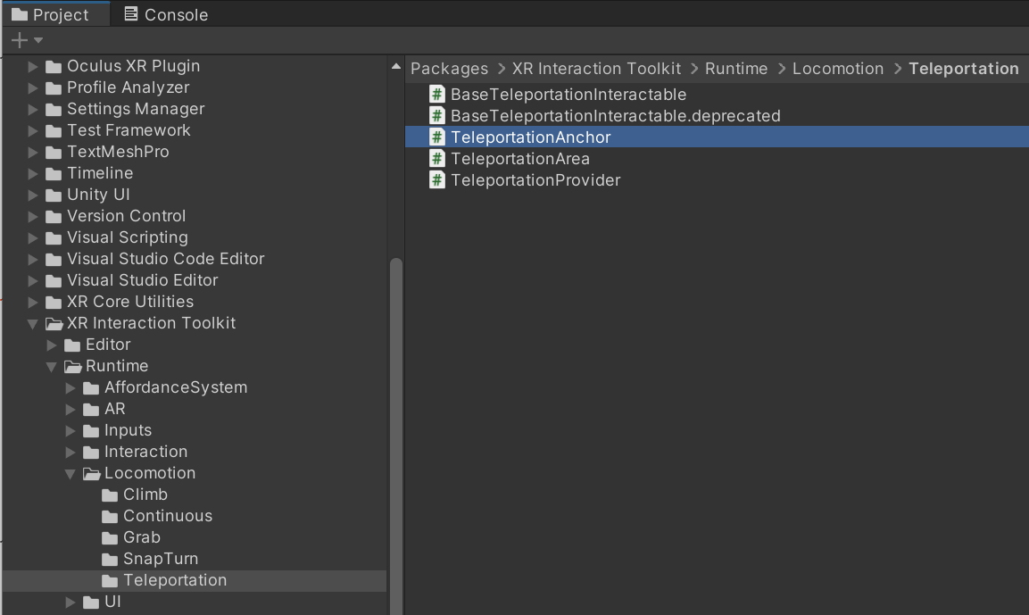
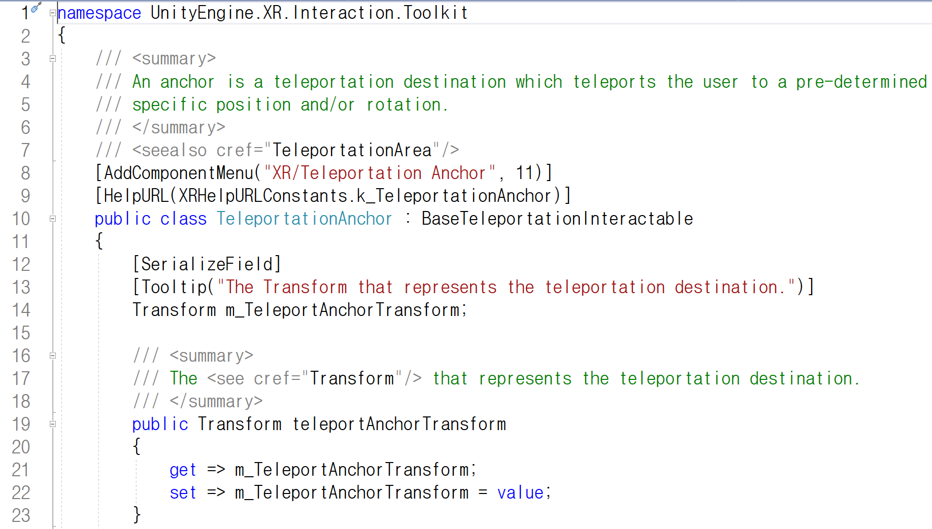
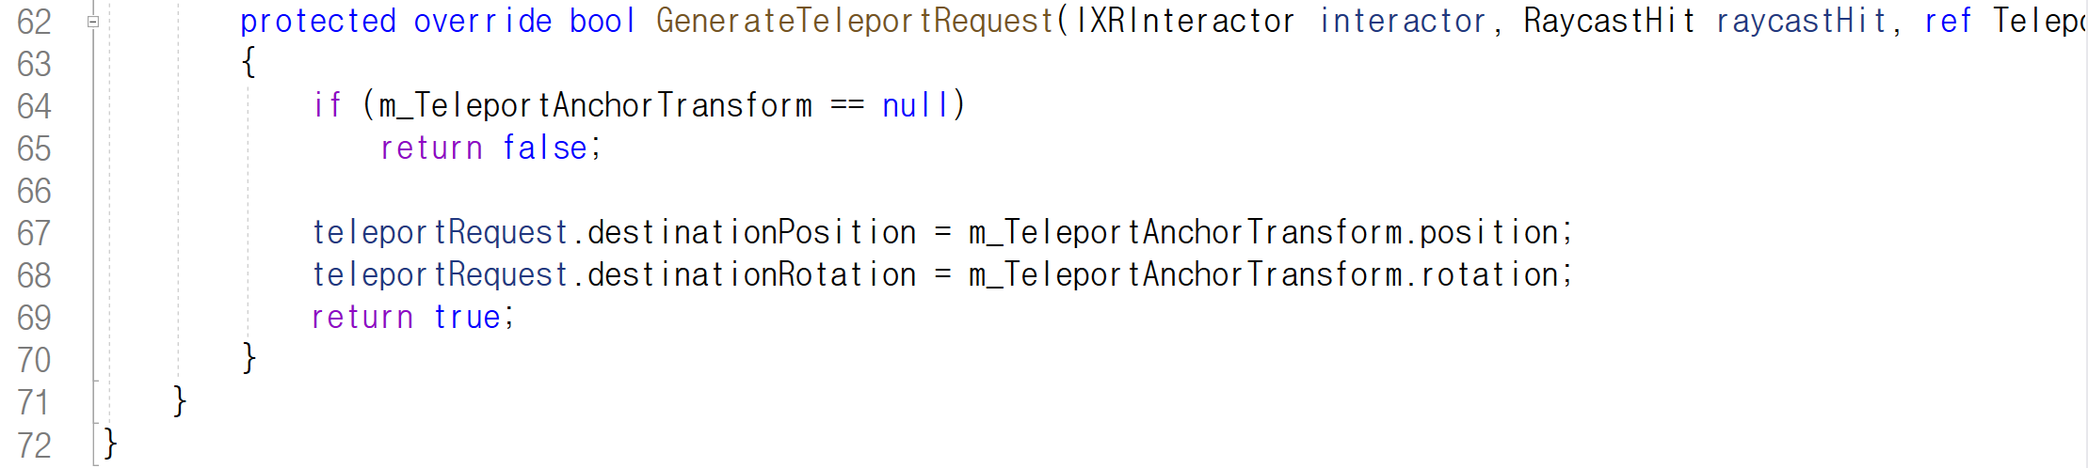
TeleportAnchor script

Slide 12
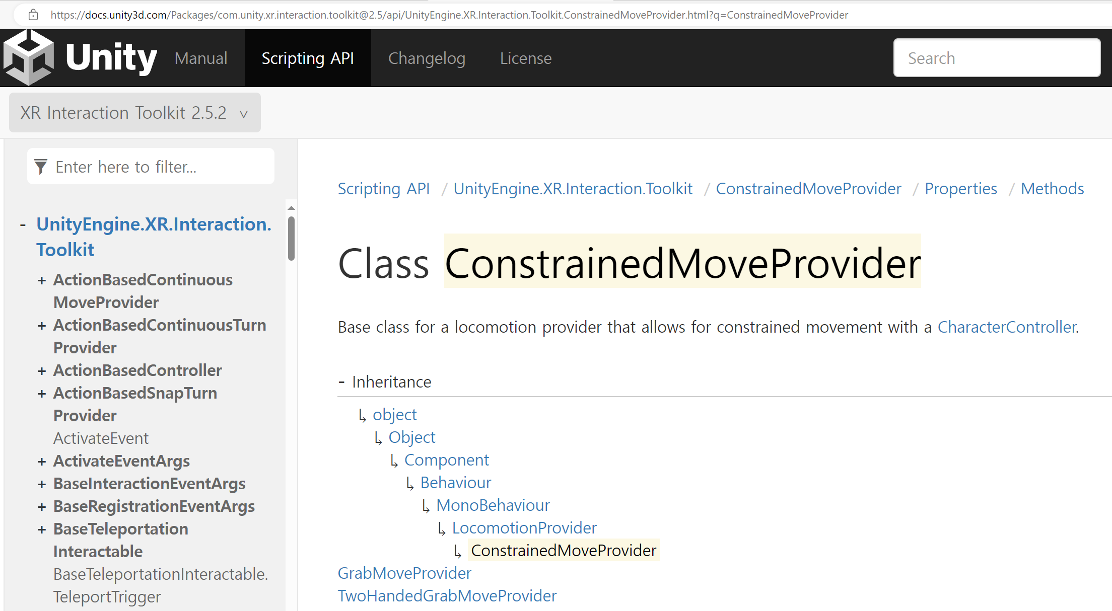
Class reference

Slide 13
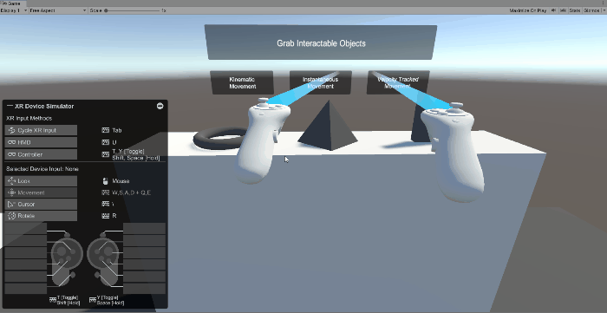
XR Device Simulator
XR Device Simulator를 하이라키창에 추가하면 헤드셑 없이 프로그램을 확인할 수 있음.
주의: 실제 헤드셑을 연결하고 테스트하는 경우에는 반드시 비활성화 해야 함.

Slide 14
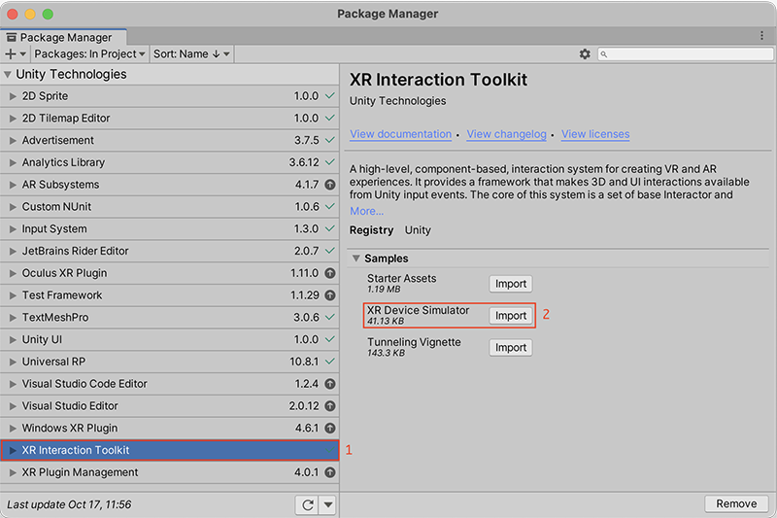
XR Device Simulator

Slide 15
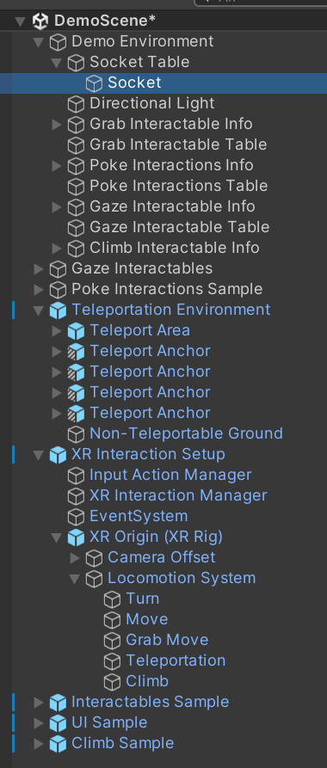
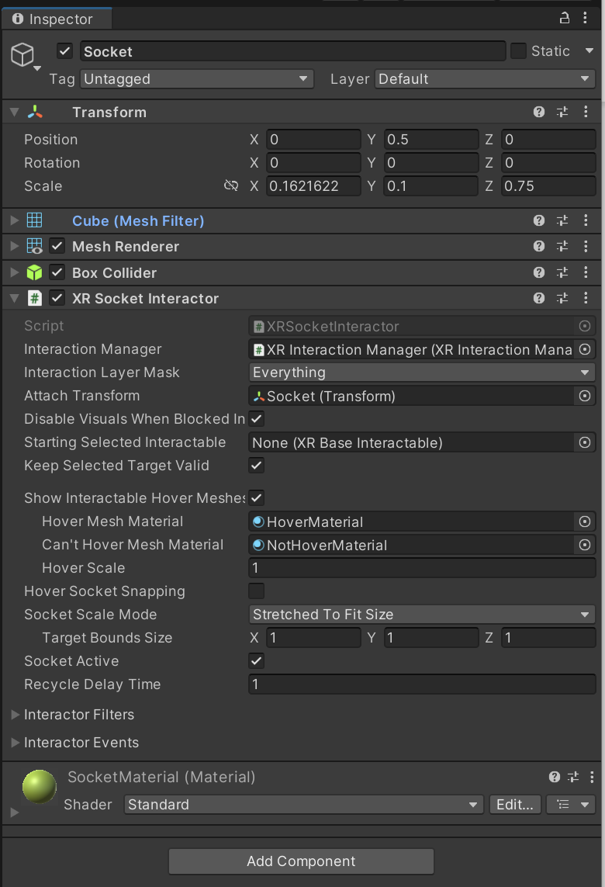
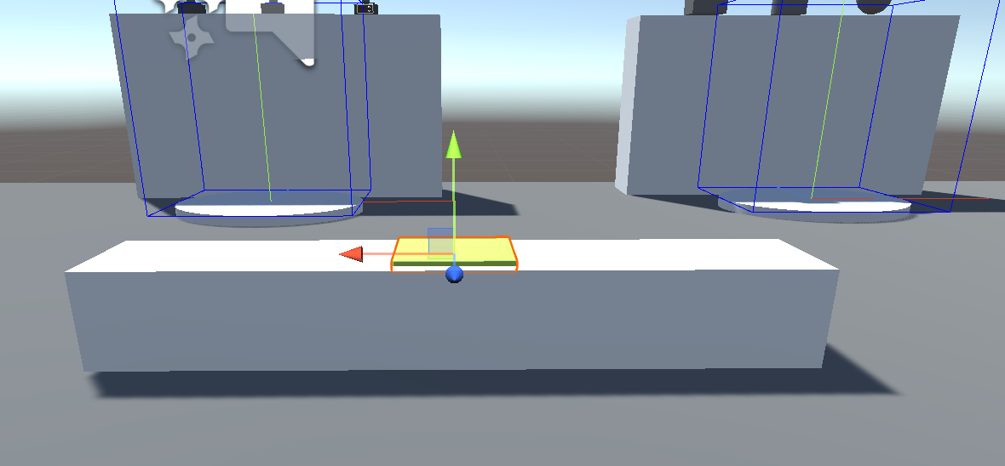
XR Socket Interactor

Slide 16
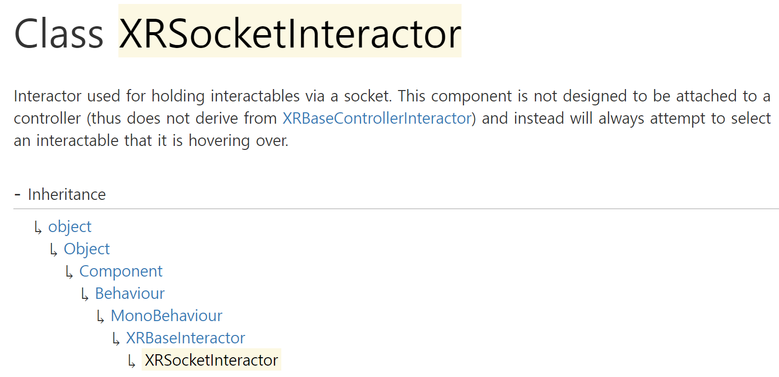
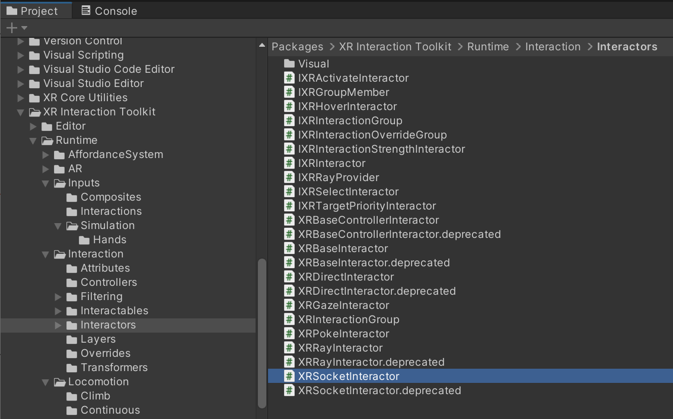
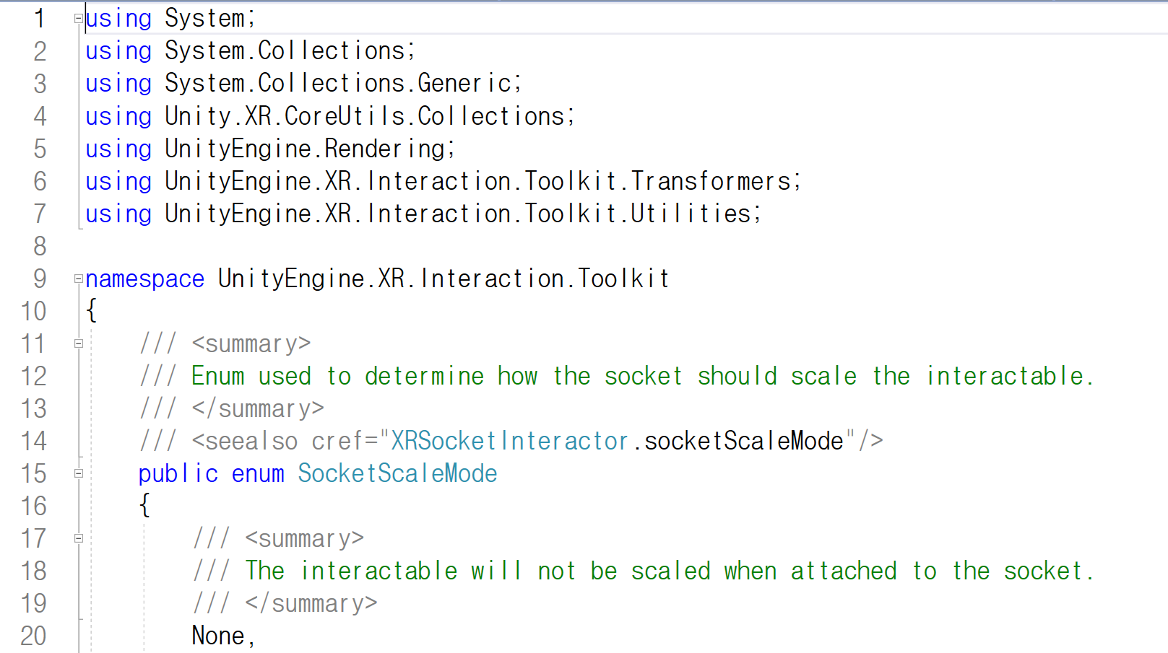
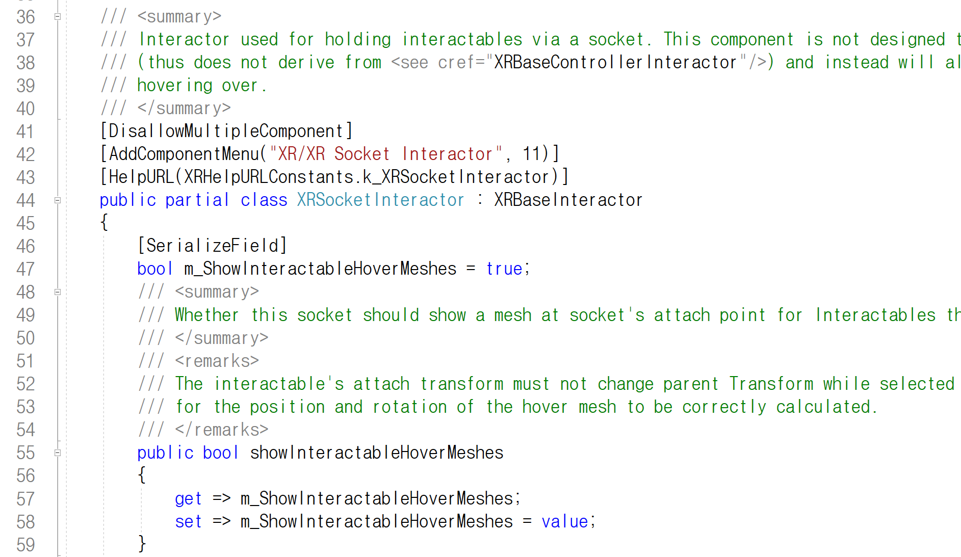
SocketInteractor script

Slide 17
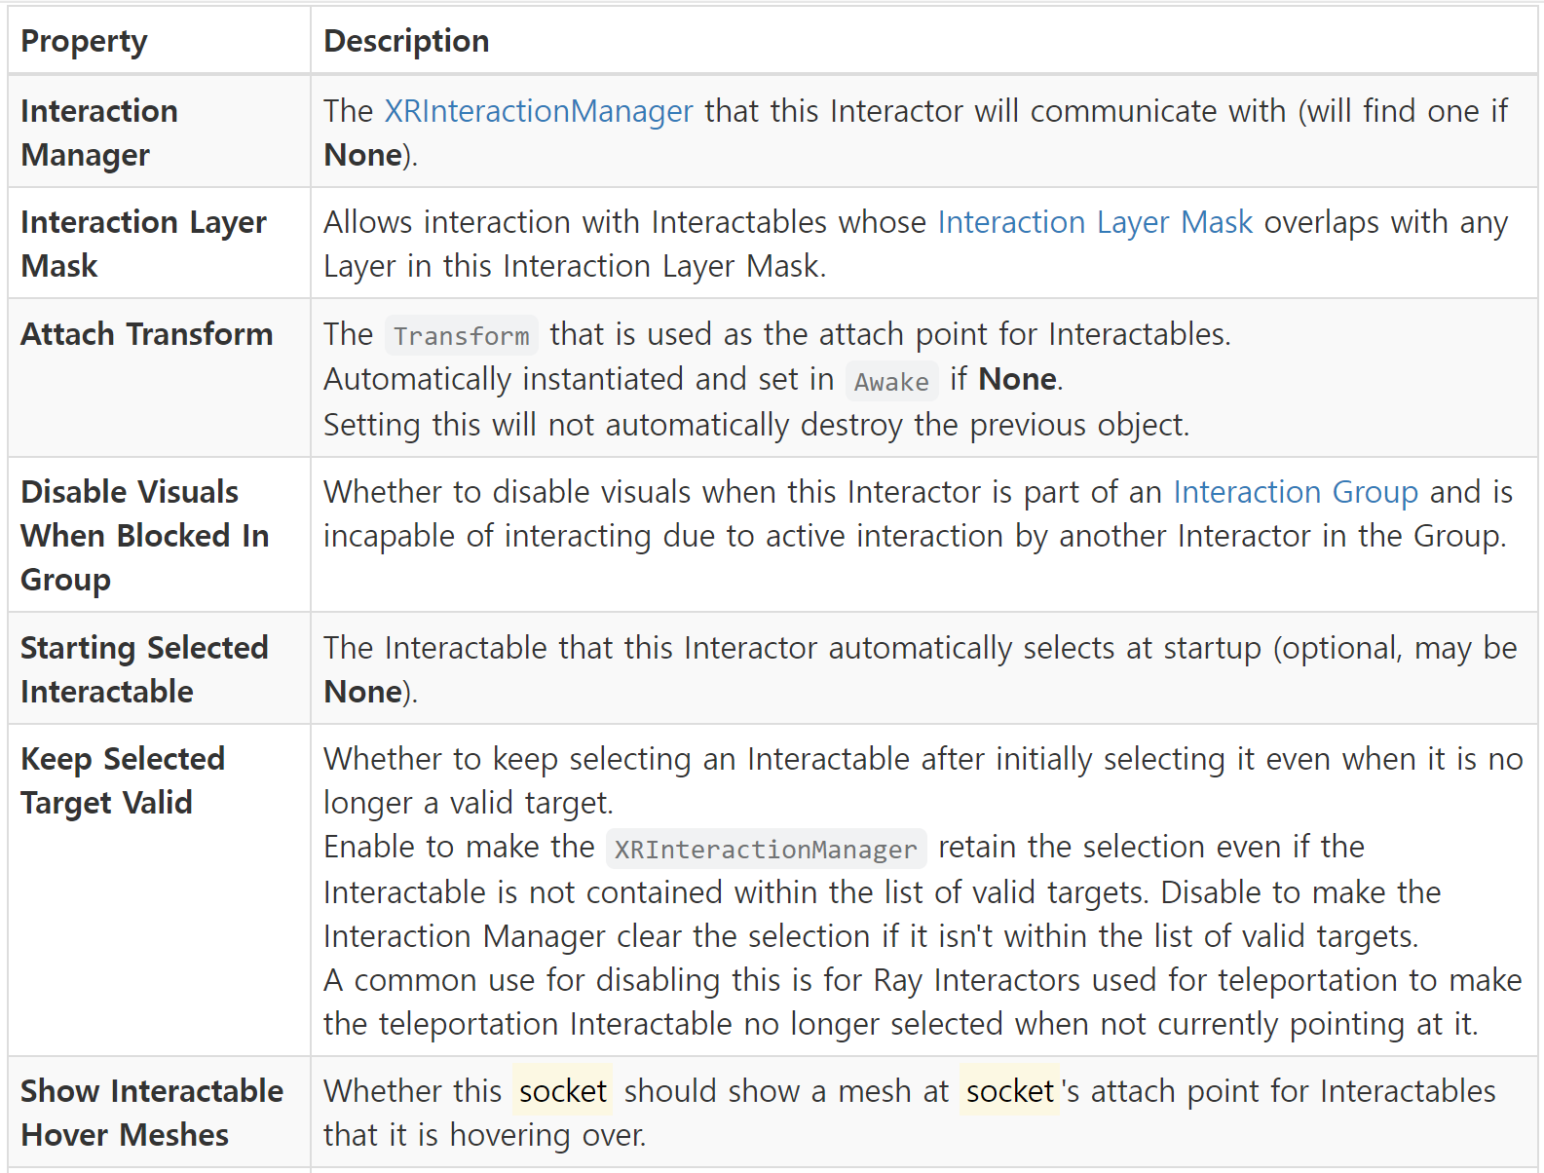
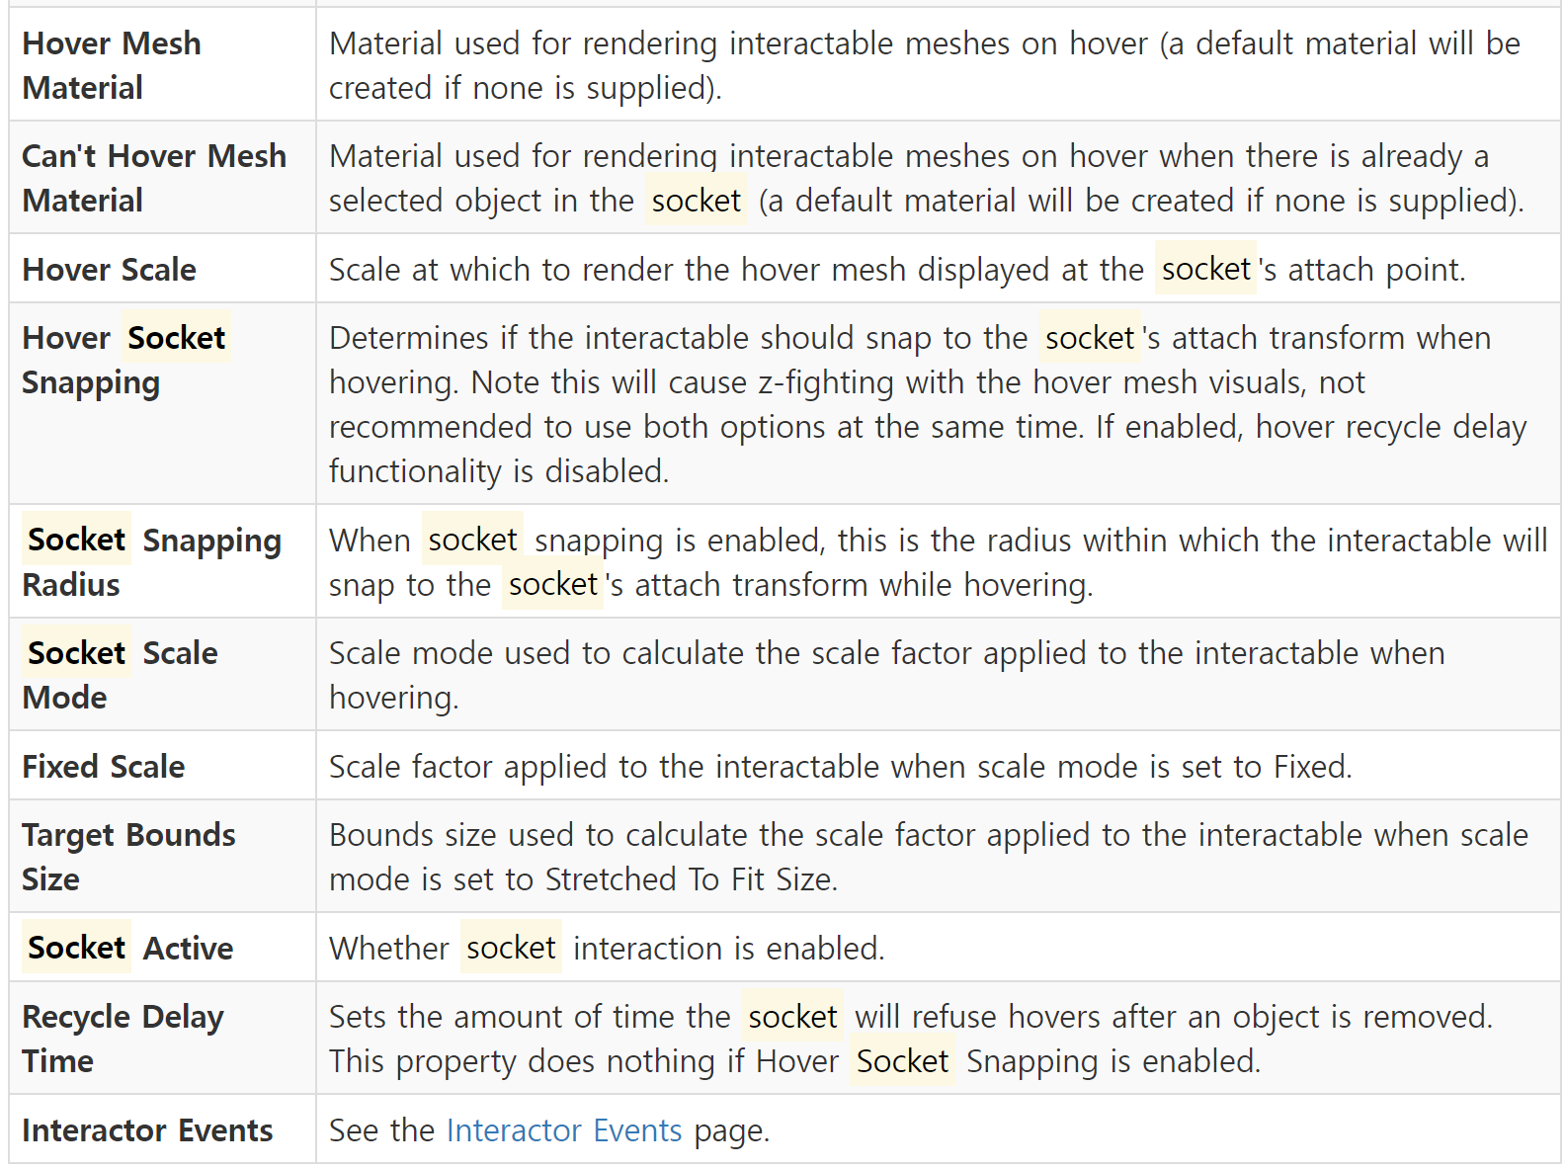
SocketInteractor properties

Slide 18
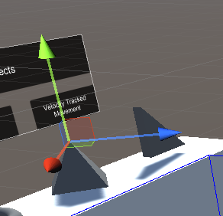
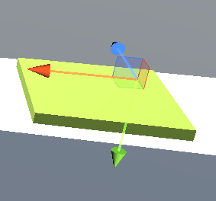
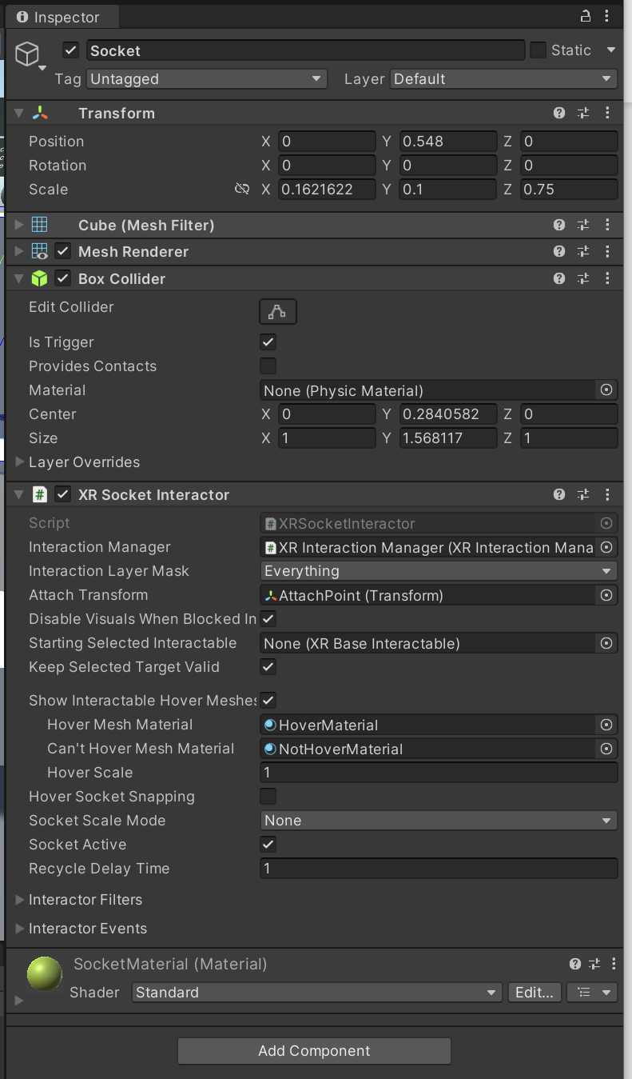
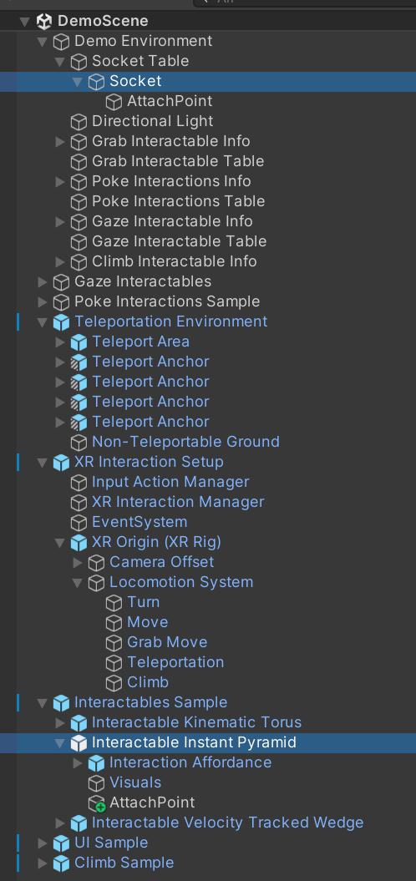
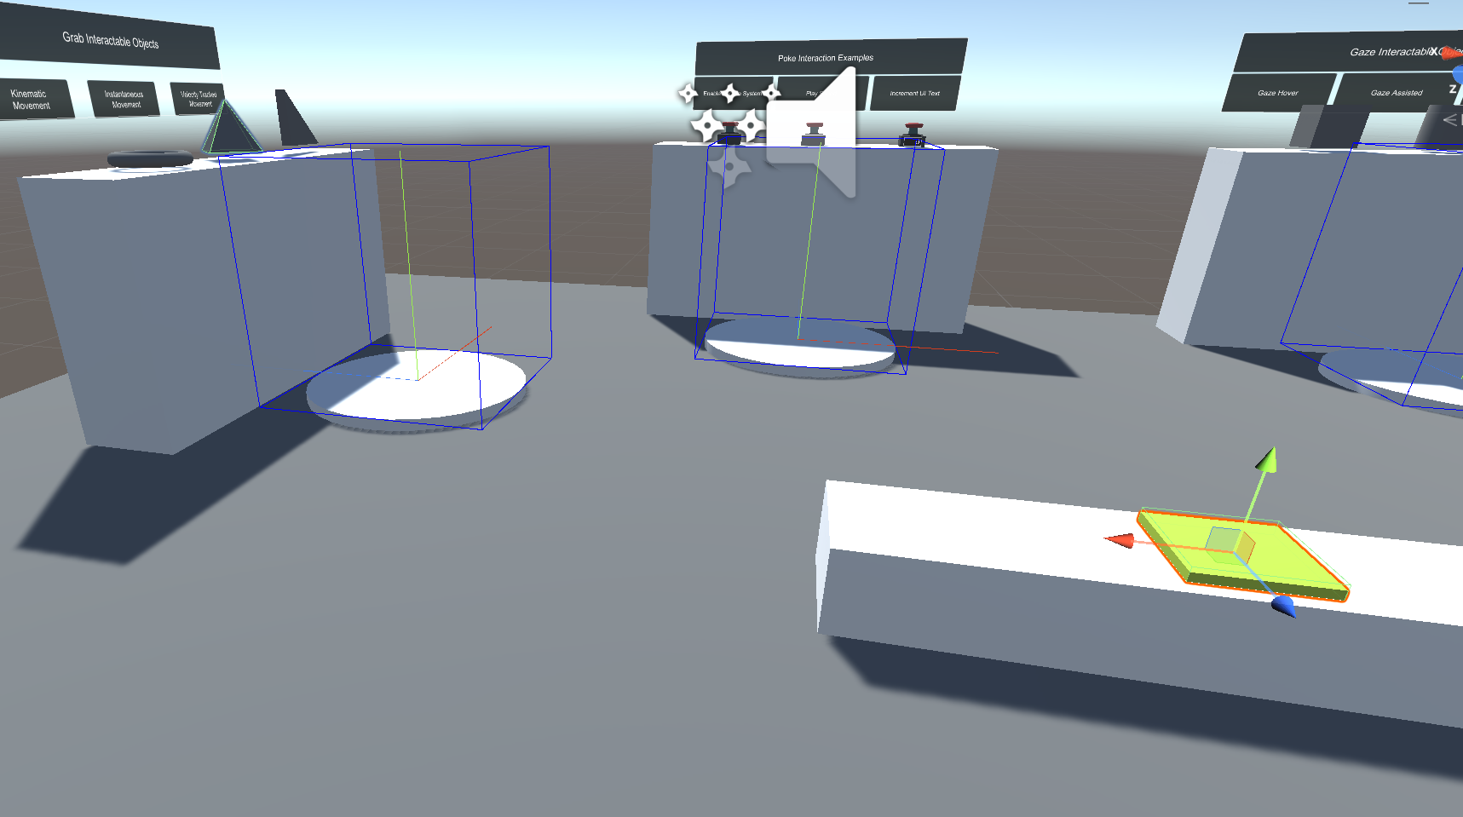
AttachPoint
XRGrabInteractable
XRSocketInteractor

Slide 19
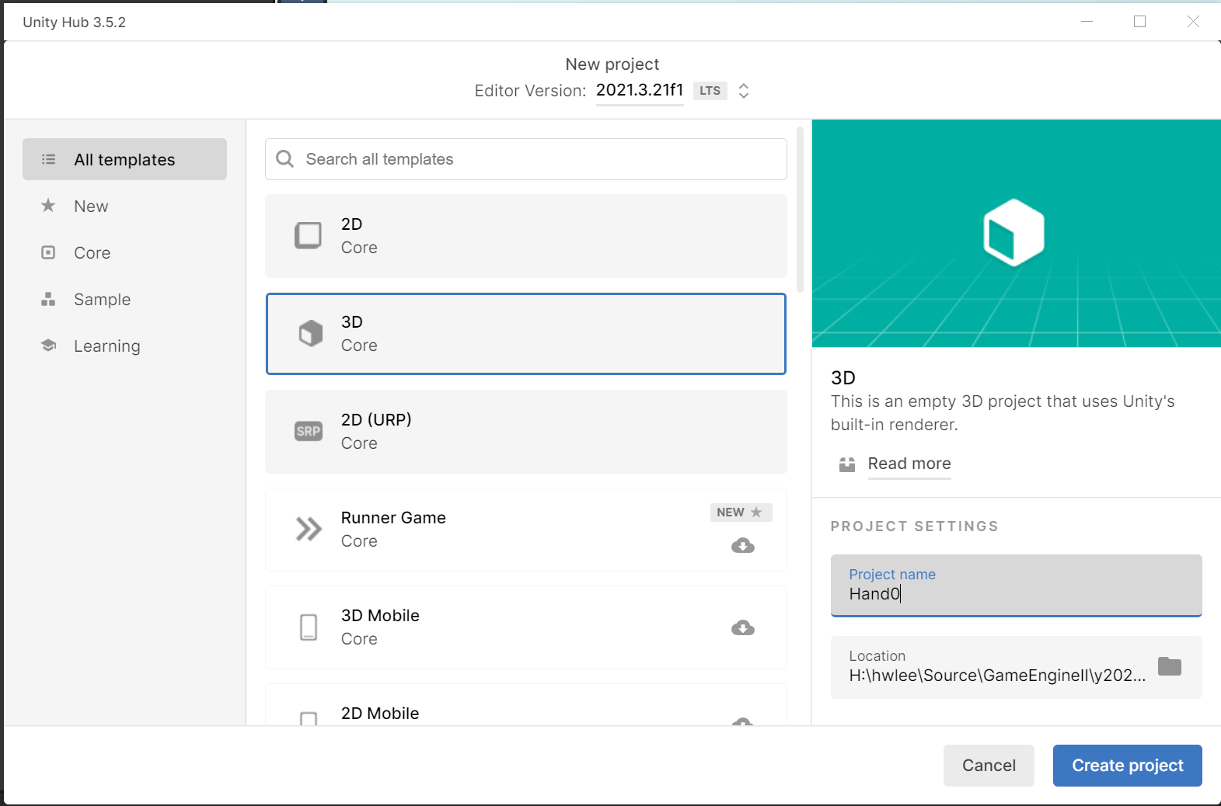
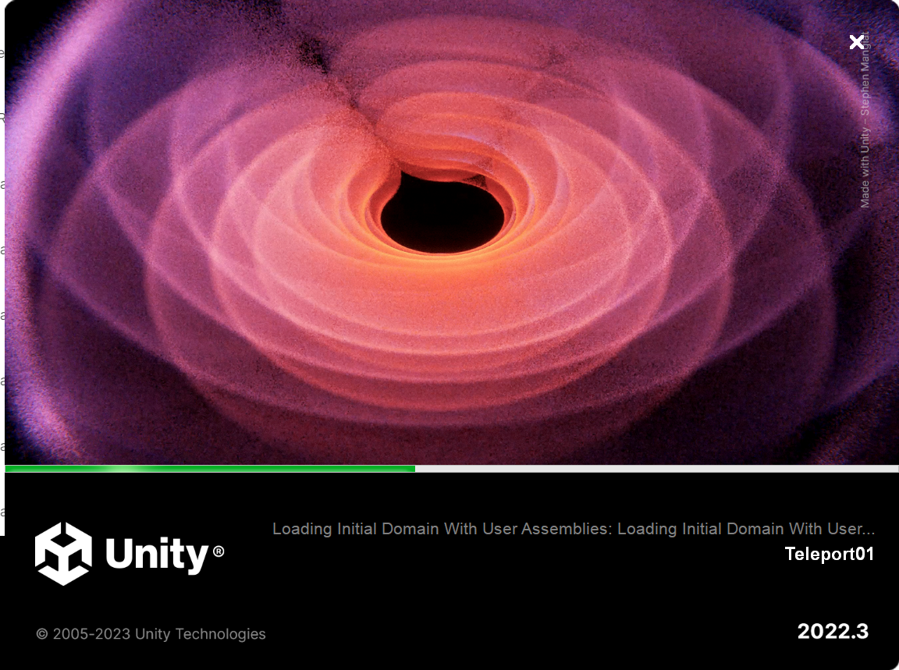
Project 생성(Teleport01)

Slide 20
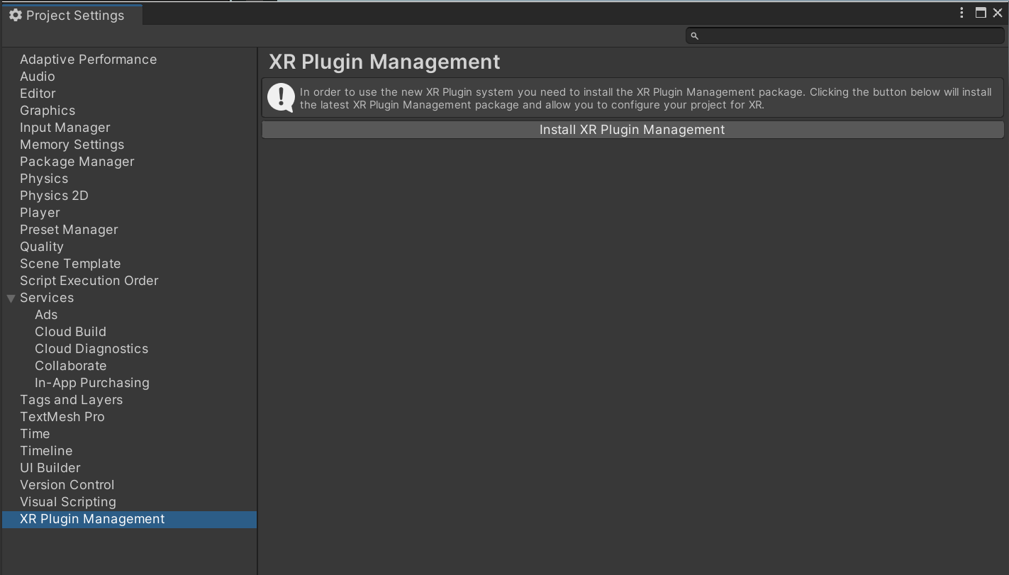
XR Plugin Management 설치

Slide 21
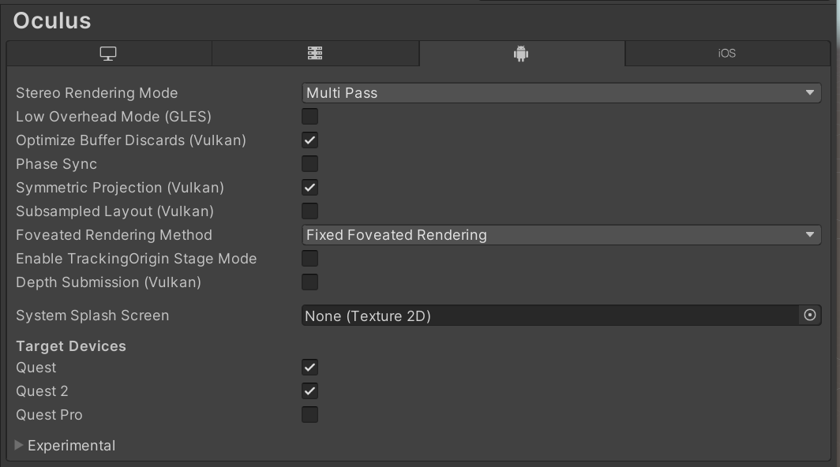
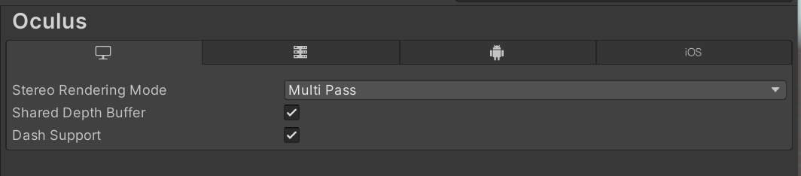
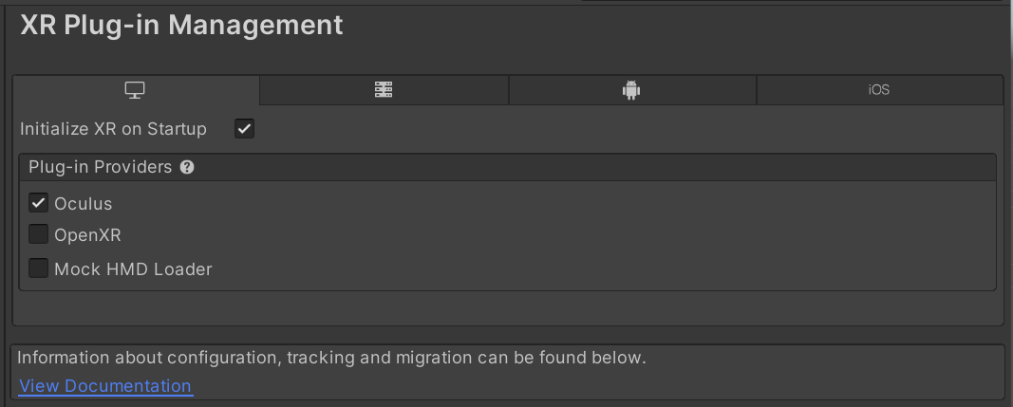
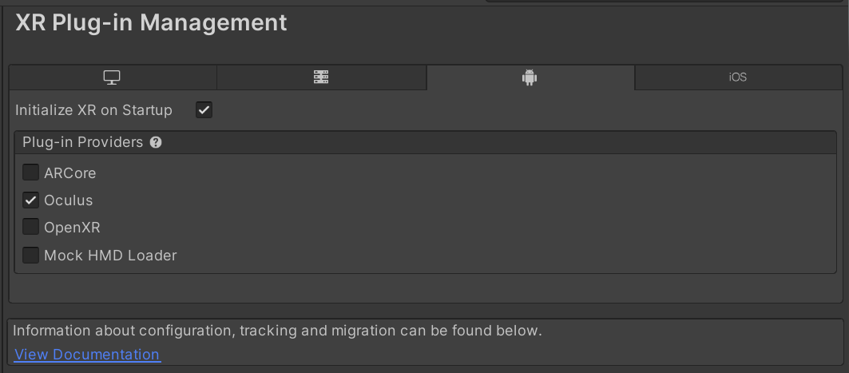
장치 설정

Slide 22
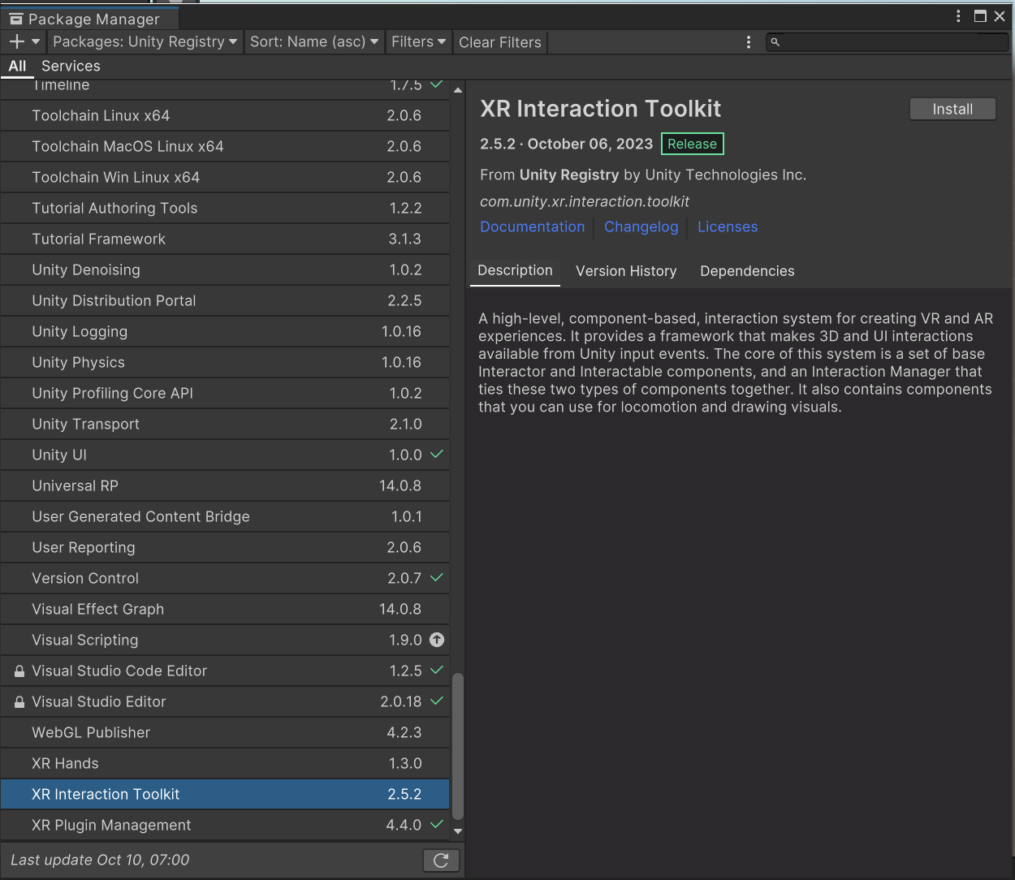
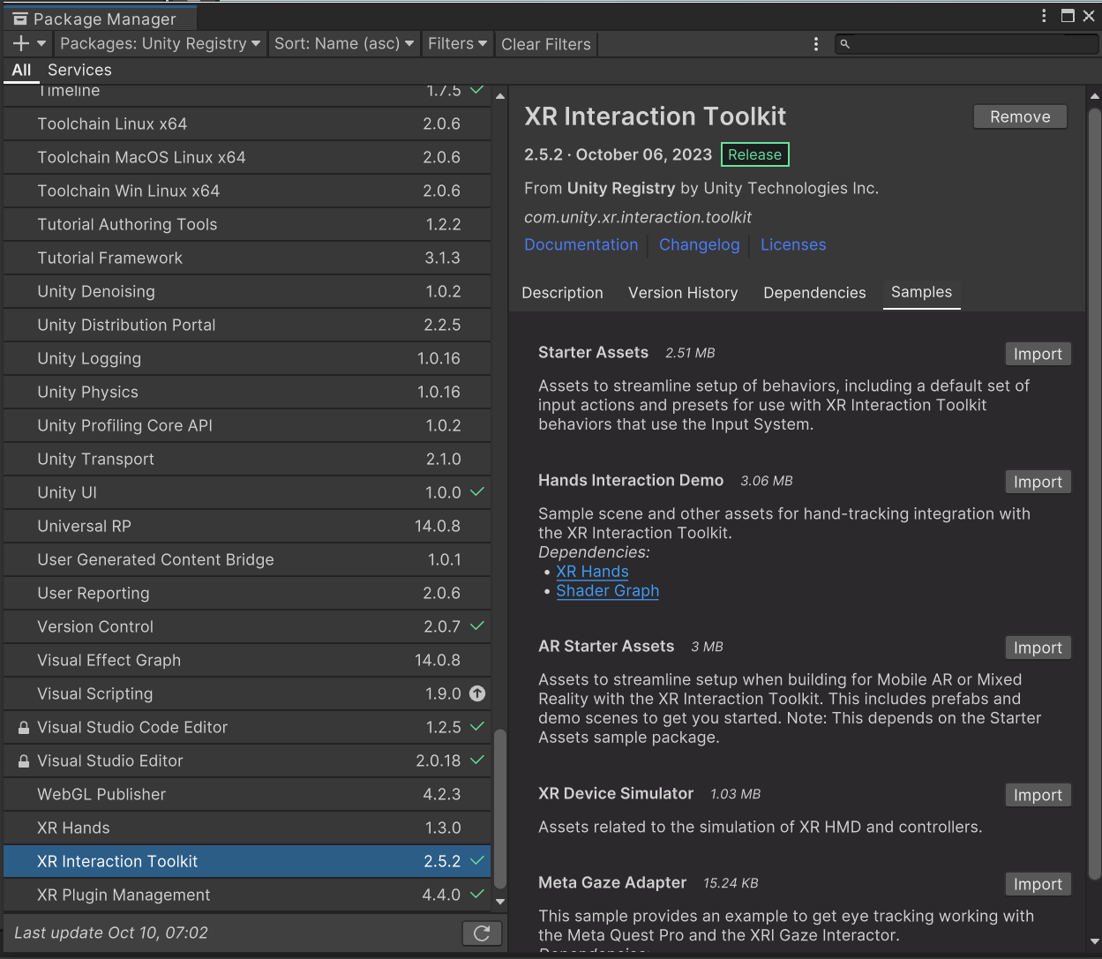
XR Interaction Toolkit 설치(버전 2.5.2)

Slide 23
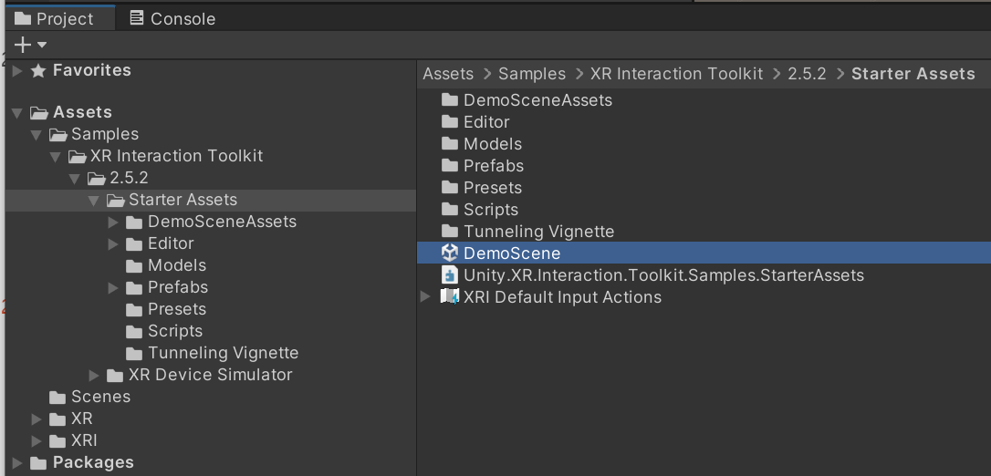
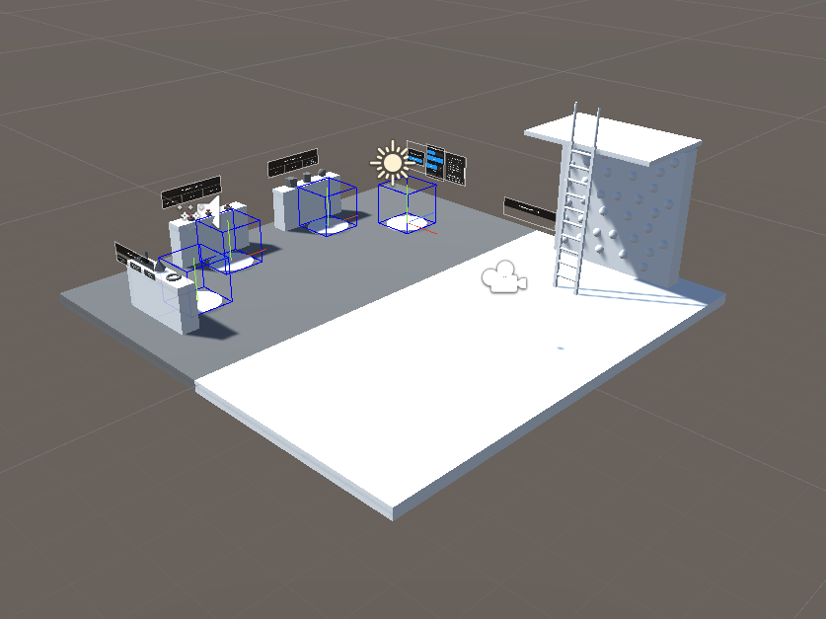
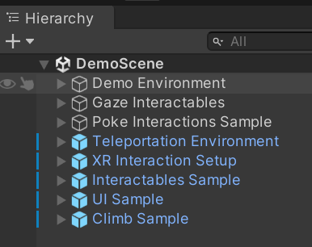
DemoScene 활성화

Slide 24


XR Origin설정 확인

Slide 25
테이블과 소켓상자 추가
Teleport01_소켓동작.mp4

Slide 26
XR Interaction Architecture/States
State | Function
Hover | If an Interactable is a valid target for the Interactor its state changes to Hover. Hovering on an object signifies an intention to interact with it, but doesn't typically change the behavior of that object, though it might create a visual indicator for this change of state, like how a hovered button changes tint.
Select | Selection requires an action such as a button or trigger press from the user to enable the Select state. When an Interactable is in the Select state, Unity considers the selecting Interactor to be interacting with it. For example, Selection can simulate picking up a grabbable object, holding a lever, or preparing to push a door that has focus via hovering.
Activate | Activation is an extra action, typically mapped to a button or trigger that affects the currently selected object. This lets the user further interact with an object they've selected. The Activate action depends on the Interactable. For example, you can use Activate to toggle a grabbable flashlight on/off or shoot a ball launcher. You can hook the component to process Activate into an action without any additional code by hooking an existing callback using the Inspector window under Interactable Events and then add to Activated via UnityEvents.

Slide 27

XR Interaction Architecture/Components
Interactors
XR Ray Interactor
상호작용 가능한 물체의 호버, 선택동작을 관장한다.
호버 또는 선택된 물체의 목록을 생성한다.
Interactables
Box, any Object in scene
Interaction 상태에 따른 행동을 정의한다.
Interaction Manager
XR Interaction Manager
Interactor와 Interactable 사이의 상호작용의 상태를 전환한다.
Interactor
Interaction Manager
Interactable

Slide 28
XR Interaction Architecture/Components
Controllers
XR Controller
입력 값들을 받아들이고 연결하는 역할을 한다.
여러 개의 Controller 를 가질 수 있다.
Controller Recorder
콘트롤러의 입력을 기록할 수 있다.
콘트롤러 없이 코드를 테스트할 때 유용한다.

Slide 29
Locomotion 시스템
XR Origin이 장면을 움직일 수 있도록 한다.
Components
XR Origin: 사용자
Locomotion System
Teleportation Provider/Interactables
Snap Turn Provider
Continuous Turn Provider
Continuous Move Provider
Grab Move Provider
Two Handed Grab Move Provider

Slide 30



Locomotion System

Slide 31


Locomotion/XR Origin
XR Origin
Property | Description
Origin Base Game Object | Indicates which GameObject acts as the Transform from tracking space into world space. In the recommended hierarchy, this is the XR Origin GameObject.
Camera Floor Offset Object | Sets which GameObject has a vertical offset applied if the device tracking origin doesn't contain the user's height.
Camera Game Object | Indicates which GameObject holds the user's Camera. This is important because the user's Camera might not be at the origin of the tracking volume. In the suggested hierarchy, this is the Camera GameObject.
Tracking Origin Mode | Sets the desired tracking origin used by the application.

Slide 32

Locomotion System
Property | Description
Timeout | Controls the maximum amount of time a single Locomotion Provider can keep exclusive access of the Locomotion System. By default, the value is set to 10 seconds.
XR Origin | Selects which XR Origin this Locomotion System will control. You can have as many Locomotion Systems and XR Origins in your scene as necessary. By default, it will find the object of type XR Origin in the scene.

Slide 33
Locomotion Providers
Teleportation
Teleportation Provider
Teleportation Area
Teleportation Anchor Interactable
Snap Turn Provider
Continuous Turn Provider
Continuous Move Provider
Grab Move Providers
Grab Move Provider
Two Handed Grab Move Provider

Slide 34
할일
XR Interaction Toolkit DemoScene에 XRSocketInteractor를 할 수 있는 낮은 테이블을 만들고 다양한 방향의 Socket포인트를 구현하시오.

